Slide 1
DAH2F3 Perencanaan Sumber Daya Perusahaan
Minggu ke-5: Production
P r o d i D 3 K o m p u t e r i s a s i A k u n t a n s i F I T , U n i v e r s i t a s T e l k o m

Slide 2
AGENDA
Deskripsi dan kegiatan tiap proses dalam siklus/proses bisnis
Komponen
Integrasi dengan komponen lain
Elemen organisasi yang terkait proses ini
Master data yang terkait proses ini
Transaksi tiap proses
Dokumen hasil transaksi
References
Monk, E., & Wagner, B. (2009). Concept in Enterprise Resource Planning Third Edition. Boston, Massachusetts: Course Technology Cengage Learning..
SAP. (2006). SAP01: SAP Overview. SAP AG.

Slide 3

Agenda
Lesson: Logistics
Procurement
Sales Order Management
Production

Slide 4
Lesson: Production
Lesson Overview
Explain production process
How production process is integrated within other solution
Lesson Objectives
Outline the tasks associated within the planning and manufacturing execution
Explain how mySAP ERP supports the key processes in Production

Slide 5
Production
mySAP ERP helps enterprise the full range of manufacturing activities.

Slide 6
Production
Through mySAP ERP, company can share manufacturing information across enterprise and supply network to coordinate production process and promote cooperation.
MySAP ERP establish critical links between sales, production planning and the factory floor.

Slide 7
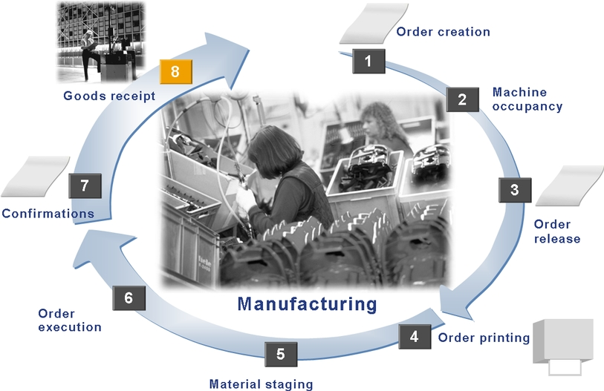
Production process Overview
0. Planning Process

Slide 8



Manufacturing Planning
Forecasting
Production and Procurement schedule for finished product and component material
Customer Demand

Slide 9
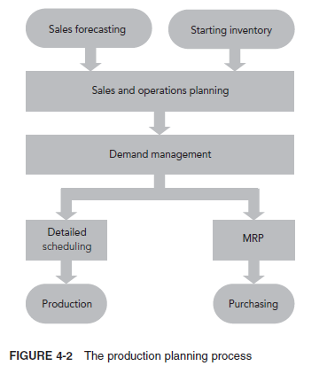
Sumber: Concept in Enterprise Resource Planning 3rd

Slide 10
Sales forecasting is the process of developing a prediction of future demand for a company’s products.
Sumber: Concept in Enterprise Resource Planning 3rd

Slide 11
Sumber: Concept in Enterprise Resource Planning 3rd

Slide 12
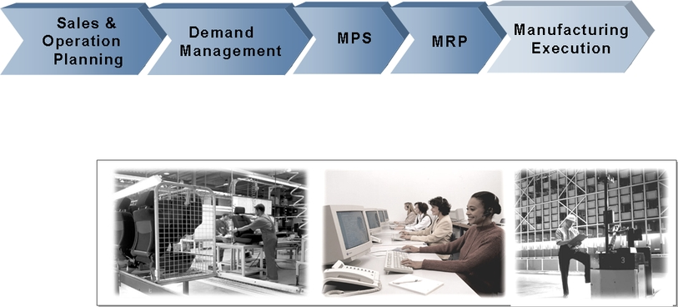
Manufacturing Planning

Slide 13
Manufacturing Planning
Sales plan &/ production plan
Determining Requirement
Forecast value & requirement from sales information system and costing/ profitability analysis
Sales and Operation Planning (SOP)
Sales and operations planning (SOP) is the process of determining what the company will produce.
Notes:
Gunakan Forecast value & requirement from sales information system and costing/ profitability analysis
Supaya bisa bikin
Sales plan &/ production plan
Sebagai input untuk
Determining Requirement
Many products have seasonal demand, and to meet demand during peak periods, production planners must decide whether to build up inventory
levels before the peak demand, increase capacity during the peak period, subcontract production, or use some combination of these approaches.

Slide 14
Sumber: Concept in Enterprise Resource Planning 3rd

Slide 15
Manufacturing Planning
Demand Management
Demand management is the process of breaking down the production plan into finer time units, such as weekly or even daily production figures, to meet demand for individual products.
Production
Scheduling
Notes:
Demand management menghubungkan Forecasting functionality dengan production scheduling.

Slide 16
Manufacturing Planning
Demand Management
Connect
Qty, dates
Forecasting
Functionality
Production
Scheduling
Notes:
Demand management menghubungkan Forecasting functionality dengan production scheduling.

Slide 17
Sumber: Concept in Enterprise Resource Planning 3rd

Slide 18
Detailed scheduling uses demand management’s production plans as an input for a production schedule (MPS).
Methods of detailed scheduling depend on the manufacturing environment. For Fitter Snacker, the detailed production schedule will determine when to switch between the production of NRG-A and NRG-B bars.

Slide 19
Manufacturing Planning
Master Production Scheduling (MPS)
OPTIONAL S T E P
Planning critical resource

Slide 20
Sumber: Concept in Enterprise Resource Planning 3rd

Slide 21
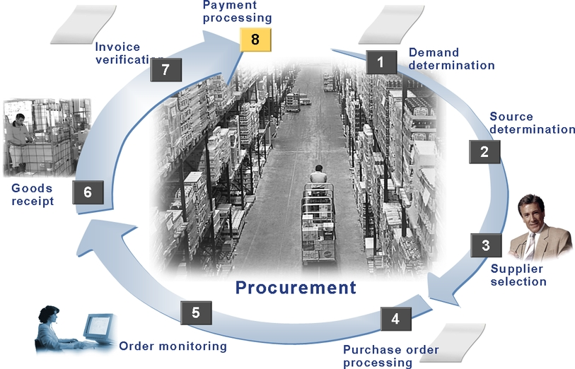
Manufacturing Planning
Material Requirement Planning (MRP)
MRP determines the amount and timing of raw material orders.
Output: Planned order or Purchase Requisition

Slide 22
Manufacturing Planning
Manufacturing Execution
Creation and release of production order
Goods issue of component
Confirmation of production activity
Good receipt of the finished goods
Planning Process Ends Here

Slide 23
Manufacturing Execution
Halaman 4-49

Slide 24
Manufacturing Execution
Completion Confirmation
1. Milestone completion confirmation
confirm all preceding operation
2. Standard completion confirmation
confirm using target value
3. Normal completion confirmation
individual completion confirmation
4. Collective completion confirmation
fast entry screen; multiple operation to confirmation
5. Completion confirmation order at order header level
automatic backflush

Slide 25
Manufacturing Execution
Good Receipt
Stock Finish Goods xxx
Revenue xxx

Slide 26
Production process Summary
Unit: Planning
Exercise 4-9 no 1. a-g
Unit: Warehouse
Unit: Planning
Unit: Warehouse
Exercise 4-9 no 3
Unit: Planning
Exercise 4-9 no 1.h
Unit: Shop Floor Control
(org lapangan)
Unit: Shop Floor Control
(org lapangan)
Unit: Shop Floor Control
(org lapangan)
Exercise 4-9 no 2

Slide 27
End of This Session

